Slide 1
CIS108-6 Data Modelling, Management and Governance
Lecture 1: Data and Data Systems
Gangmin Li
(Office hours: 13:00-17:00 every Friday)

Slide 2
Today’s schedule
What is data - Data in DIKW framework
Data Systems
Data, Database Management Systems (DBMS)
Relational DBMS (RDBMS)
IS Development Methods

Slide 3

Sport club – assignment case

Slide 4
What are needed for the club?
A computer based system that can manage booking, checking and update bookings…
Parties involved:
People (staff, instructors, members, …)
Rules (one activity per day, no more than 2 hours …)
Facility (swimming pool, badminton court, sport hall …)
Activities (class, exercise …)
… represented by
Data

Slide 5
What is data?
Definition:
Originally, data is plural for “datum”, a Latin word
A “datum” is a single factual, a single entity a single point of matter
Datums are most often called “data points”
Data represents a collection of data points
We speak also of datasets instead of data (dataset is a collection of data points)
Today “data” is used in both singlar and plural form

Slide 6
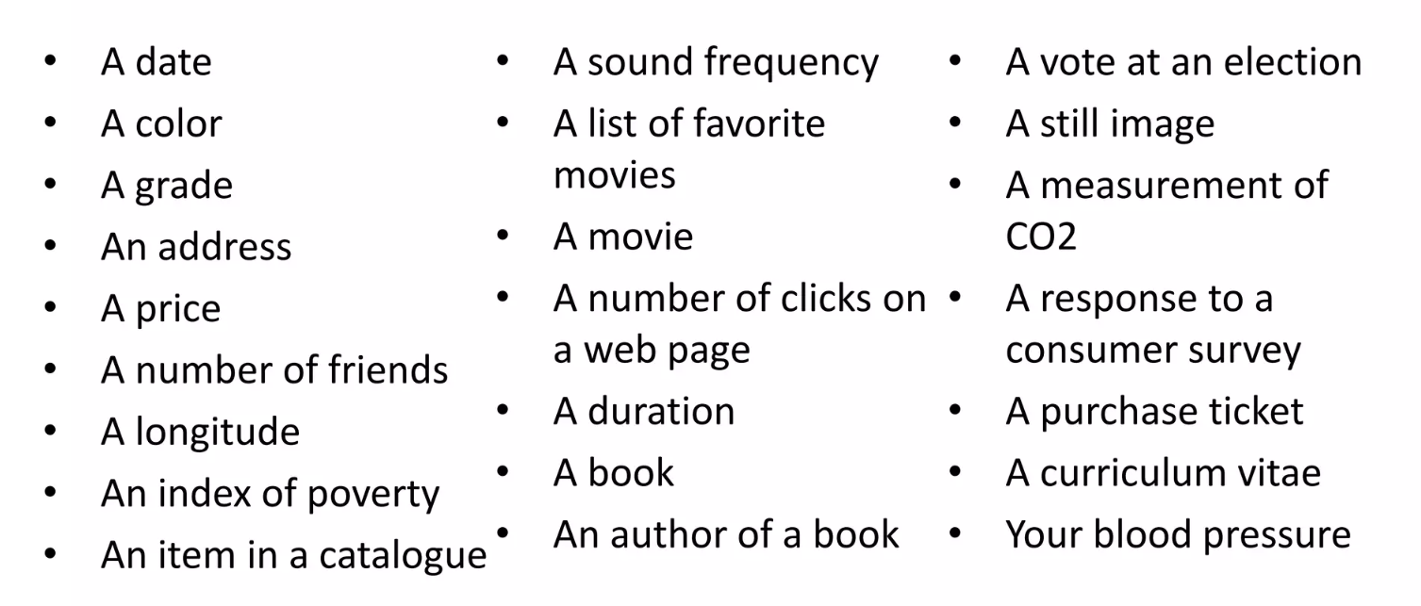
Examples

Slide 7
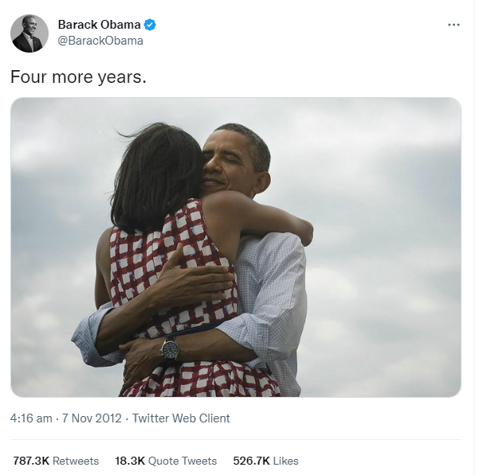
An example of a data point
“Four more year. http://t.co/bAJE6Vom”
It has text, image, symbols, numbers, …
All of them are discretion of the data point.

Slide 8
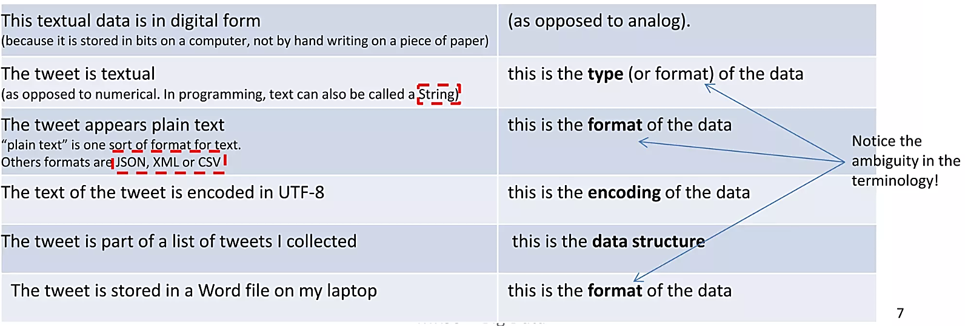
An example of a data point
“Four more year. http://t.co/bAJE6Vom”

Slide 9
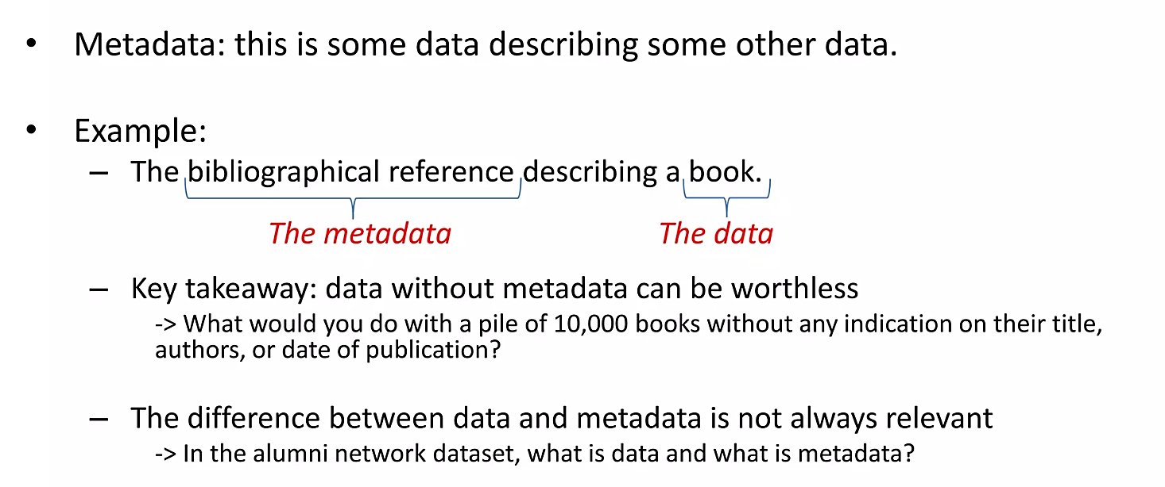
Data or Metadata?

Slide 10
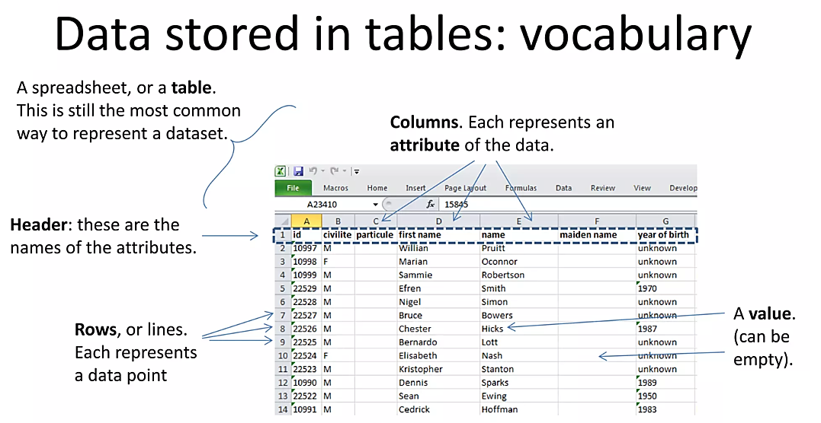
Data: How do we talk about it?

Slide 11
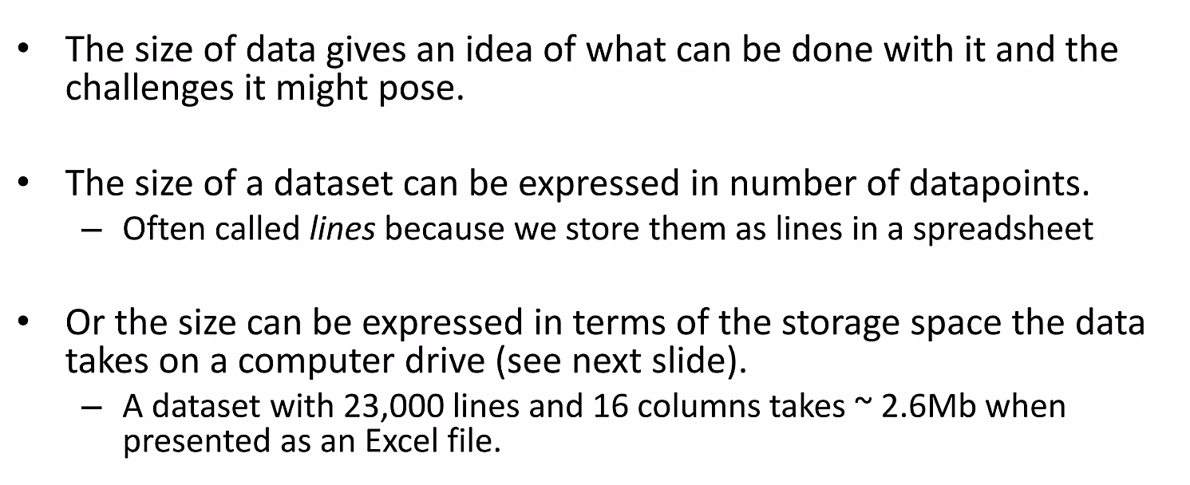
Data and Size

Slide 12
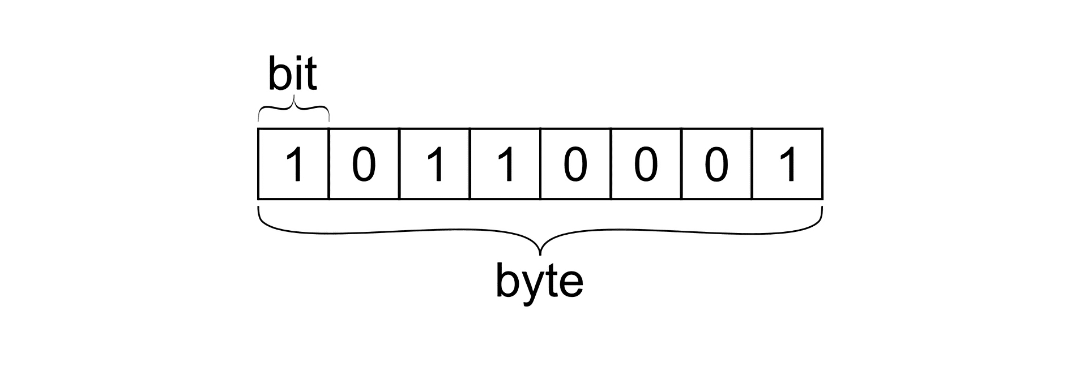
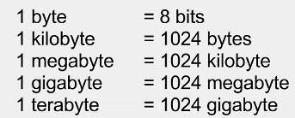
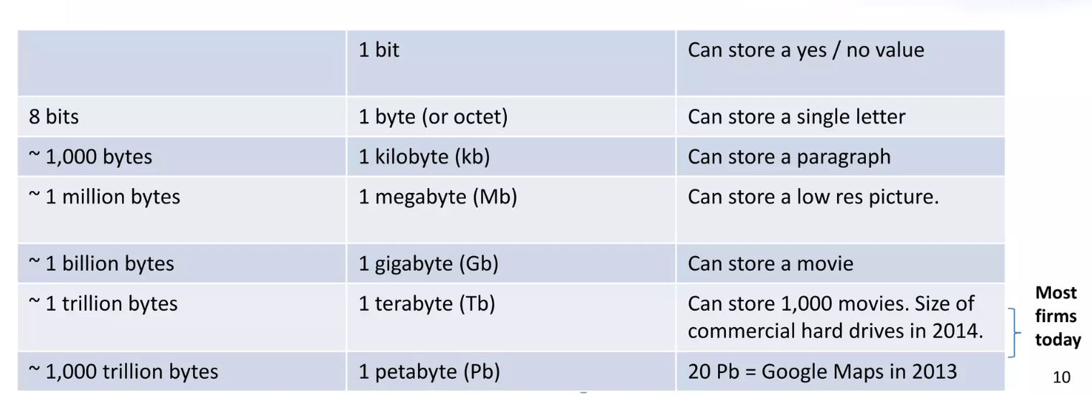
Bytes

Slide 13
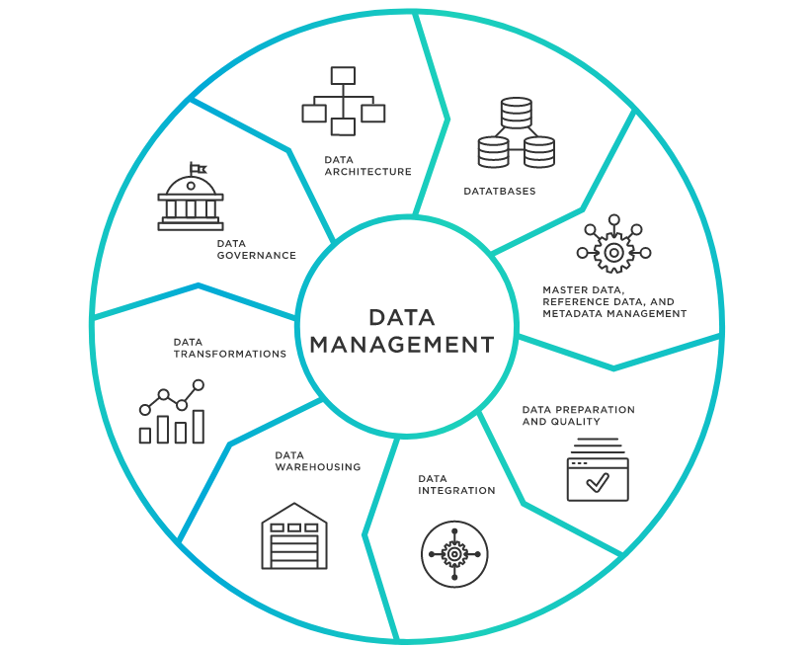
What is Data Management?

Slide 14
What is Data Management?
Data management enables consistent accessibility, delivery, governance, and security of data to meet an organization’s requirements using tools including master data management, data virtualization, data catalog, and self-service data preparation and wrangling.

Slide 15
Why do we need data management?
Organizations can unify all of their data intelligently for better access, trust, and control.
Improving customer experience, optimizing operations, or transforming an organization
Unify disparate data sources in a well-governed, consistent manner can enable teams across the enterprise to make faster, smarter decisions.
Single source of shared data asset can support different users and different use cases across the business to meet today’s most complex challenges with data-driven intelligence.

Slide 16
Characteristics of a Successful Data Management
Data governance: defines data ownership, access rules, ensure data integrity and security
Data management systems ensure the easy access
Effective use of data (in operation, analytics and data-based decision making)

Slide 17
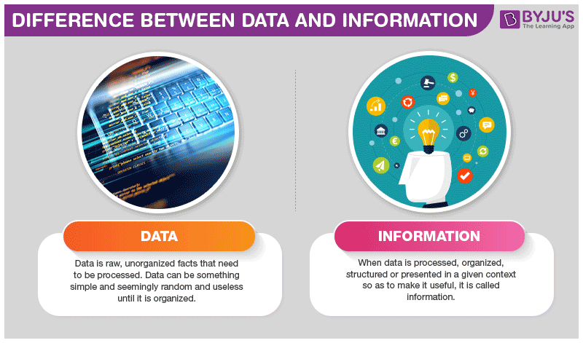
Data or information?

Slide 18
Data And Information
What are?

Slide 19
Data
Raw data has no (or hard to get its) meaning!
Example:
12012012
What does it mean?
Formatting: 12/01/2012 – we added meaning!
Data ambiguous – 1st of December in the US, 12th of Jan in Europe
12th of Jan, 2012 would be 2012/01/12 in China

Slide 20
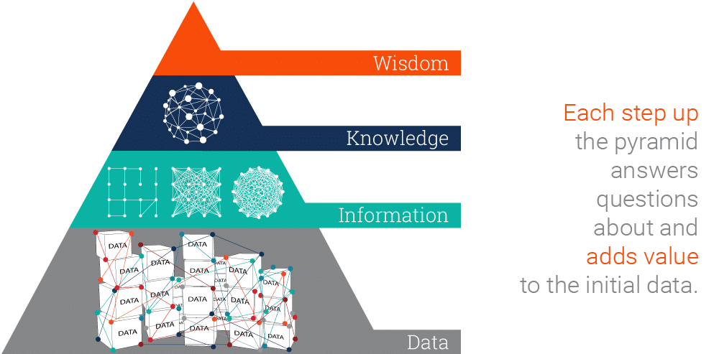
Data, Information, Knowledge, Wisdom (DIKW) Pyramid
The DIKW Pyramid represents the relationships between data, information, knowledge and wisdom..

Slide 21
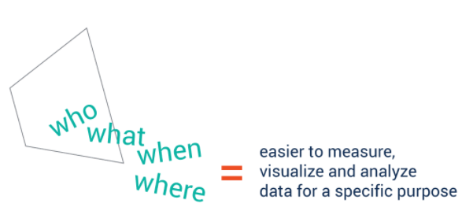

Information
Information is data that has been processed (cleaned) to make it meaningful and useful (for special purposes).
For instance, from a list of marks (data) you could infer that girls did better than boys (information)
Good quality information should be
Accurate
Up-to-date
Relevant
Complete
On-time
Appropriately presented
Intelligible

Slide 22
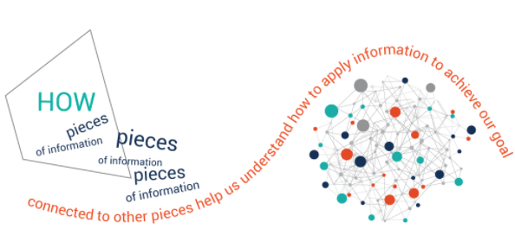

Knowledge
“Information in action” – the part of information that is applied to solve a problem.
Knowledge is not just a description of collected facts (information), but also understand how to apply it to achieve goals.
Knowledge is recipients' reflection or reaction of information being received

Slide 23

Wisdom
Wisdom is knowledge applied in action.
We must answer questions such as ‘why do something’ and ‘what is best’.
After so many actions the knowledge left stand the test.

Slide 24
Thinking
Example:
A house wife (have 5 kids) heard that the oil price at Nasdaq is 98 pence per litre today, the next day, she go to a patrol station to fill her tank. Explain what is the data and what is information, knowledge and wisdom in this situation?

Slide 25
Now we know …
Data are Facts or statistics used for processing, analysis to get information
Information is processed data/interpreted data. Assign data with some meaning
(put into an Excel with column headings)
Examples:
Completed questionnaire from market research maybe considered to be …
The final report that analysing the completed questionnaire and reporting findings may be considered as …
Data
Information

Slide 26
Data & Information
42
gender
response
Male | Yes
Female | Yes
Male | Yes
Female | Yes
Male | No
Male | Yes
Female | No
People who were asked
‘do you
like watching TV?’
Is it:
Price?
Age?
Code?
Hours?
Kilos?
The answer to life and everything?
WHAT?

Slide 27
Information Revolution
Information is playing an increasingly important economic, social, political and technological role in many of our lives
Played a key role in agricultural and industrial revolutions
Information continues to play a key role in these developments
Now – the information revolution is happening in its own right

Slide 28
Importance of Information
Information is such an important resource that:
“Information is information, not matter or energy” [Wiener, Norbert (1961). Cybernetics; or, Control and communication in the animal and the machine. Cambridge: M.I.T. Press.]
Should be considered as the third fundamental part of the universe alongside matter and energy.

Slide 29
But how data are transformed in to Information …

Slide 30
Data, Information Management Systems
Data, information are managed by computer …

Slide 31
Information Management Systems
Information Management System (IS in short): “A system to collect, process, store, transmit and display information” (Wood-Harper 1990)
Systems to:
Store
Manipulate
Extract needed information (satisfy information need)
From ….. Data!

Slide 32
IS: to satisfy information needs
IS
provider
seeker
Information System
Information Source
Information beneficiary
University Library
Telephone
Wikipedia
Television
DVLA
Newspaper
Computer
Internet
Atlas

Slide 33
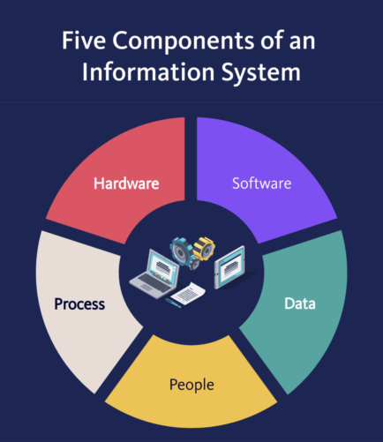
5 Components of an Information System
Hardware
Software
Data
People
Process

Slide 34
Information System (Computer)
Modules data Students data
IS
provider
medium
seeker
Information
Information Source
Information beneficiary
User needs
to access
multiple data
Data

Slide 35
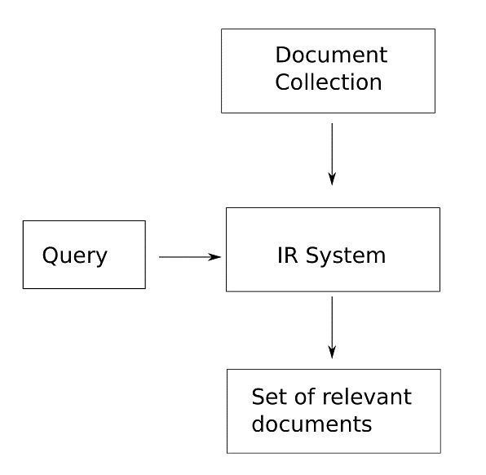
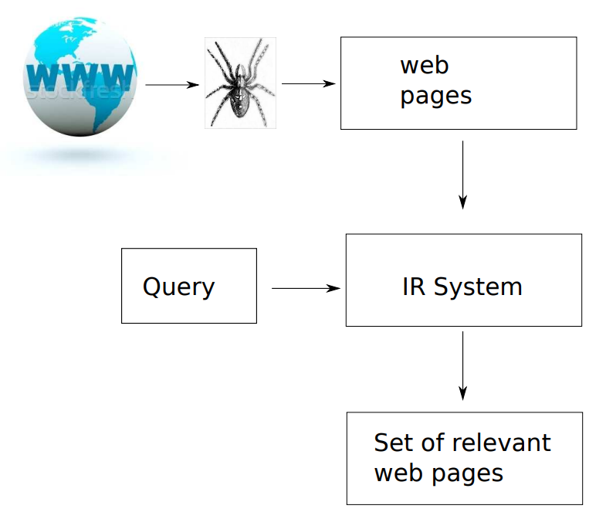
Information systems and Internet
General IS
Internet IS

Slide 36

Computer-based information systems
“A shared collection of logically related data (and a description of this data), designed to meet the information needs of an organization.” (Connolly & Begg 2002)
Notes:
Some issues of data management become clear when looking at card indexes

Slide 37



Internet-based Information System
Internet (Infrastructure):
Web: (Rules: http, HTML, Hyperlinks)
Clouds (Applications)

Slide 38
Database Management System
A Database Management System (DBMS) is a system designed to store, manage, and facilitate access to databases.
“A shared collection of logically related data (and a description of this data), designed to meet the information needs of an organization.” (Connolly & Begg 2002)
Involvement of:
Hardware
Software
Humans

Slide 39
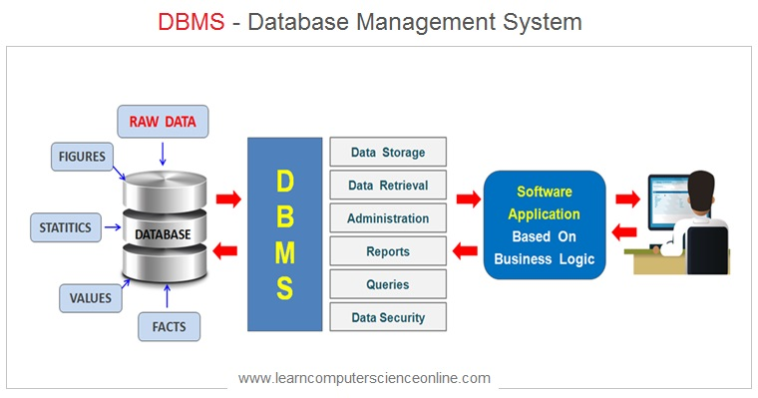
Computer based Data (management) systems

Slide 40
Database Management System (DBMS) on the web
Report
Application
1
Application
2
Enquiry
Retrieve
Update
Delete
Database Management System
DATASTORE
Modules data Students data
Control
Security
Integrity
Notes:
Datastore controls the resources (concurrency control) and provides mechanisms to ensure security and integrity.
Database Management System (DBMS) provides interface to query, retrieve, update and delete data
Applications, but also creation of report about the data stored make use of the DBMS.

Slide 41
Some DBMS Functions
Interface between user and the data
Data Storage, retrieval & update
A user accessible catalogue
Transaction support
Other Services:
Concurrency control
Recovery
Authorization
Safeguards data against corruption

Slide 42
DBMS Types
Hierarchical
Network
Deductive
Relational (RDBMS)
Object-Oriented (OODBMS)
Hybrid (Object-Relational)
NoSQL ("not only SQL")
Probabilistic Databases
Probabilistic Relational Algebra
Notes:
Hierarchical Database: tree-like structure, parent-child relationship, created by IBM in the 60s. XML is a modern example
Network Database: graph-like structure
Deductive: derive new facts from rules and facts; for instance Datalog
NoSQL: Do not use SQL, differ from RDBMS in some significant ways, may not guarantee ACID. Example: BigTable (Google), graph databases, RDF.
We focus on RDBMS in our unit.

Slide 43
Relational Databases Management (RDBMS)

Slide 44
Relational Model
A model proposed by E. F. Codd (1970). The great strength of the RD model is its simple logical structure (math based)
Communications of the ACM,
Volume 13(6), 1970

Slide 45
Relational Database (RD)
“A data model that represents data in the form of tables or relations” (Hoffer 1999)
“A table is in more traditional parlance, a file. A table has rows and columns, which, more traditionally, are known as records and fields/attributes” (Chester & Athwall 2002)
Each relation has a name and is made up of named attributes/columns of data. Each row contains one value per attribute
IBM & ORACLE (1980s)

Slide 46
Data Model
A data model is a collection of concepts for describing data.
A schema is a description of a particular collection of data, using the given data model.
The relational model of data is the most widely used model today.
Main concept: relation, basically a table with rows and columns.
Every relation has a schema, which describes the columns, or fields.

Slide 47
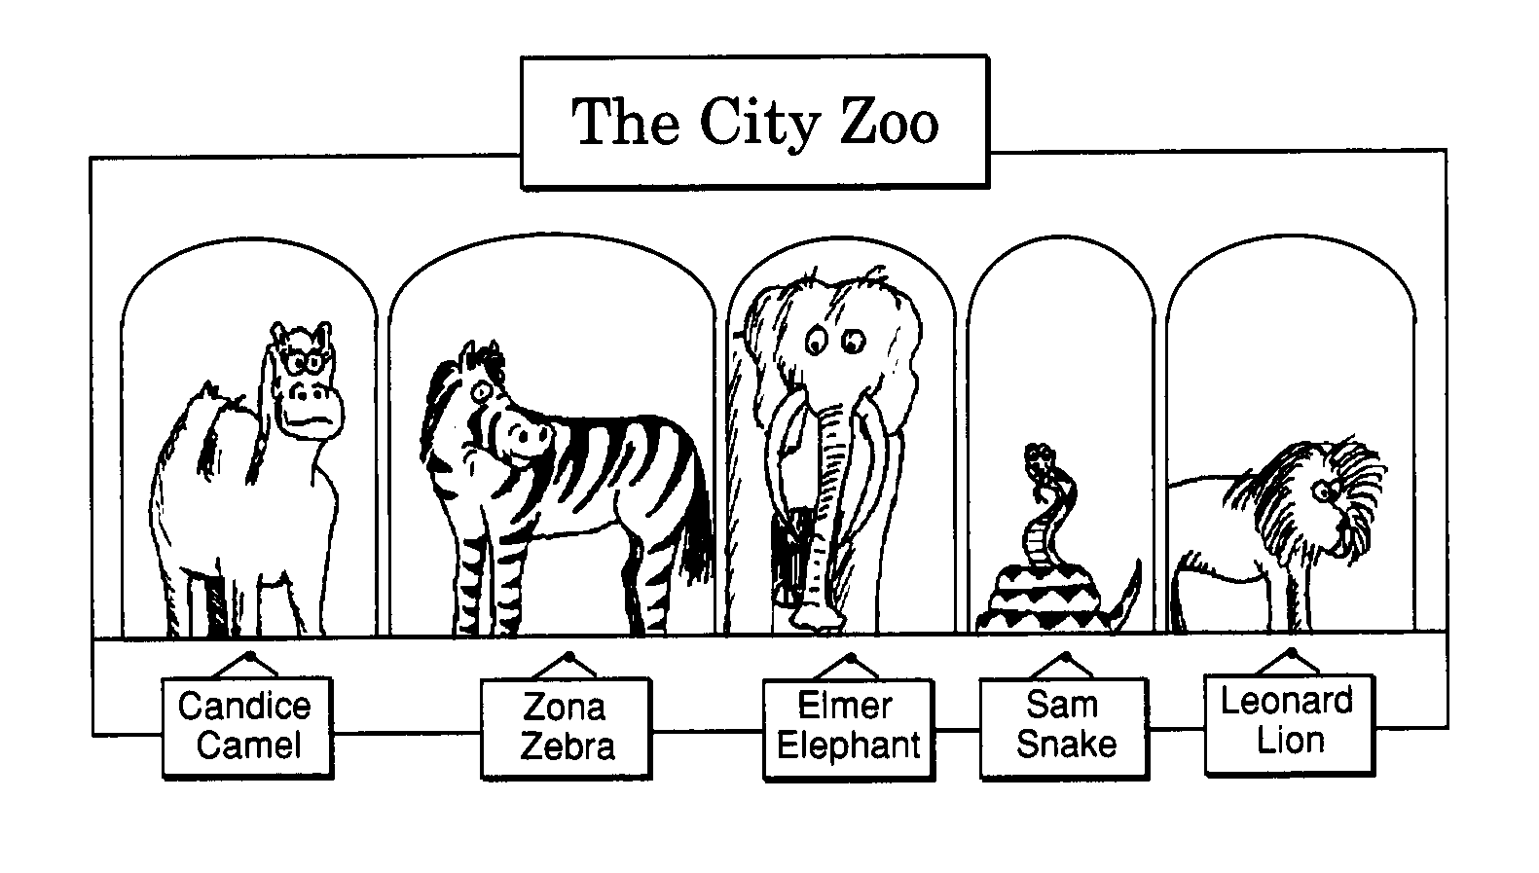
An Example – Relational data model
A relation is a 2-D table made up of columns and rows

Slide 48
Terminology
mondeo
mondeo
discovery
galaxy
Attributes
Domain = 4, 7, 8
Cardinality = 5
Degree = 3

Slide 49
Primary Key
PRIMARY KEY : unique identifier for each row
Primary Key
No part of the primary key may have a null value
This is known as the entity integrity rule

Slide 50
Foreign Key
Foreign Key: A column or columns in one table that reference(s) a primary key column or columns in another table
Values in a foreign key must match an existing value in the primary key or be NULL. This is known as the referential integrity rule.
Foreign Key
Primary Key

Slide 51
Database Languages
DDL: Data Description Language
used to specify the data in the database
DML: Data Manipulation Language
used to access and update the data
DCL: Data Control Language
used to control access to the data
Some databases have a combined DDL, DML and DCL (often called a Query Language), e.g. SQL
SQL Plus for Oracle
Notes:
SQL: Structured Query language

Slide 52
Abstraction Levels
Many external schemata, single conceptual (logical) schema and physical schema.
External schemata/views describe how users see the data.
Conceptual schema defines logical structure
Physical schema describes the files and indexes used.
External
Schema 1
External
Schema 2
External
Schema 3
Conceptual Schema
Physical Schema
Schemas are defined using DDL; data is modified/queried using DML

Slide 53
Data Independence
Applications insulated from how data is structured and stored.
Logical data independence: Protection from changes in logical structure of data.
Physical data independence: Protection from changes in physical structure of data.
View 1
View 2
View 3
Conceptual Schema
Physical Schema
DB

Slide 54
*** system Development

Slide 55
Need for a Methodology
Define what are required
What is the detailed system specification
How to model data?
How to design a efficient database management system?
Keep a written report to document all causes of all successes and failures too!

Slide 56
That is the content for next lecture!

Slide 57
Review
What is data and how does it differ from information?
What is concurrency control?
What is a primary key?
What is data independence?

